Slide 1
4. Bitcoin Network and Blockchain
Mastering Bitcoin - Programming the Open Blockchain, 2nd Ed., 2017

Slide 2
Peer-to-Peer Network Architecture (1/2)
Bitcoin is structured as a peer-to-peer (P2P) network architecture on top of the Internet.
P2P means that the computers that participate in the network are peers to each other, that they are all equal, that there are no “special” nodes.
There is no server, no centralized service, and no hierarchy within the network. Nodes in a P2P network both provide and consume services at the same time with reciprocity acting as the incentive for participation.
P2P networks are inherently resilient, decentralized, and open.
The term “Bitcoin Network” refers to the collection of nodes running the bitcoin P2P protocol.

Slide 3
Peer-to-Peer Network Architecture (2/2)
In addition to the bitcoin P2P protocol, there are other protocols such as Stratum that are used for mining and lightweight or mobile wallets.
These additional protocols are provided by gateway routing servers that access the bitcoin network using the bitcoin P2P protocol and then extend that network to nodes running other protocols.
For example, Stratum servers connect Stratum mining nodes via the Stratum protocol to the main bitcoin network and bridge the Stratum protocol to the bitcoin P2P protocol.
We use the term “extended bitcoin network” to refer to the overall network that includes the bitcoin P2P protocol, pool-mining protocols, the Stratum protocol, and any other related protocols connecting the components of the bitcoin system.

Slide 4
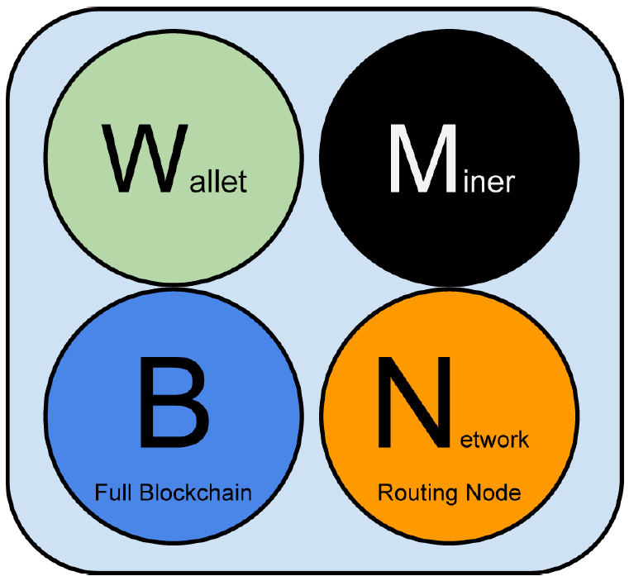
Node Types and Roles (1/2)
All nodes include the routing function to participate in the network and might include other functionality. All nodes validate and propagate transactions and blocks, and discover and maintain connections to peers.

Slide 5
Node Types and Roles (2/2)
Full nodes
Maintain a complete and up-to-date copy of the blockchain. Full nodes can autonomously and authoritatively verify any transaction without external ref.
Simplified Payment Verification nodes (lightweight nodes)
Maintain only a subset of the blockchain and verify transactions using simplified payment verification (SPV).
Mining nodes
Compete to create new blocks by running specialized hardware to solve the Proof-of-Work algorithm.
Wallets
Many user wallets, especially those running on resource-constrained devices such as smartphones, are SPV nodes.

Slide 6
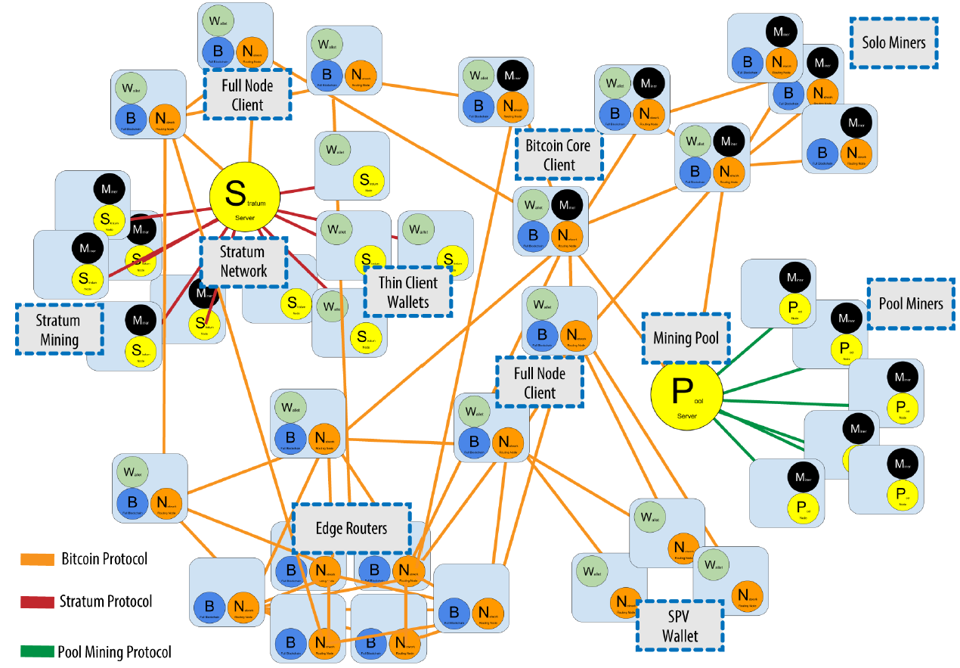
The Extended Bitcoin Network (1/2)

Slide 7
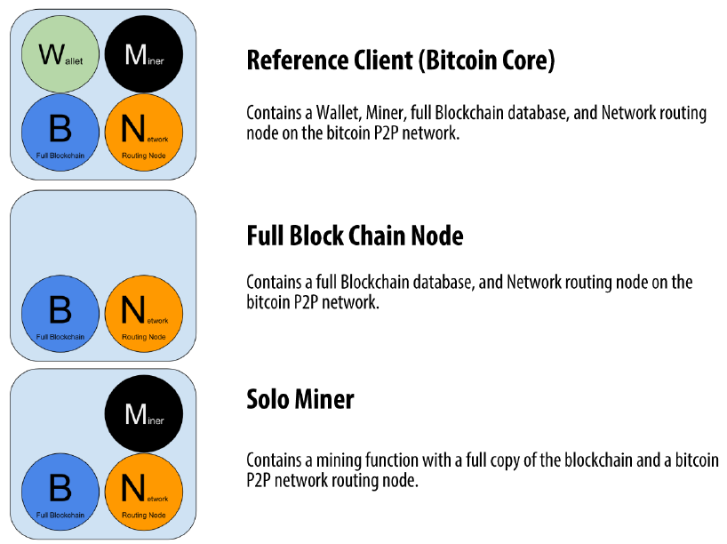
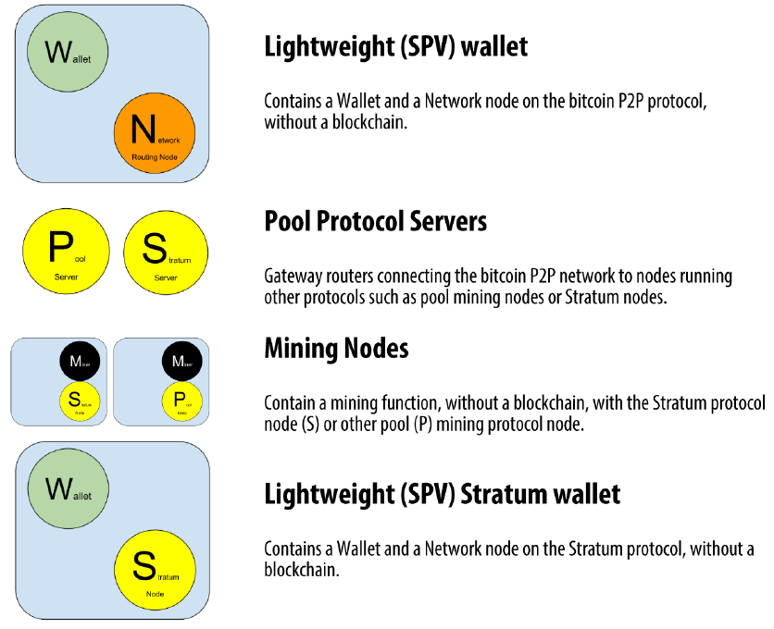
The Extended Bitcoin Network (2/2)

Slide 8
Network Discovery
When a new node boots up, it must discover other bitcoin nodes on the network in order to participate.
To start this process, a new node must discover at least one existing node on the network and connect to it. The geographic location of other nodes is irrelevant; the bitcoin network topology is not geographically defined. Therefore, any existing bitcoin nodes can be selected at random.
To connect to a known peer, nodes establish a TCP connection, usually to port 8333 (the port generally known as the one used by bitcoin), or an alternative port if one is provided.
Once one or more connections are established, the new node will send an addr message containing its own IP address to its neighbors. The neighbors will, in turn, forward the addr message to their neighbors, ensuring that the newly connected node becomes well known and better connected.

Slide 9
Full Nodes
Full blockchain nodes maintain a complete and up-to-date copy of the bitcoin blockchain with all the transactions, which they independently build and verify, starting with the very first block (genesis block) and building up to the latest known block in the network.
A full blockchain node can independently and authoritatively verify any transaction without reliance on any other node or source of information.
The full blockchain node relies on the network to receive updates about new blocks of transactions, which it then verifies and incorporates into its local copy of the blockchain.
If you need a lot of disk and it takes a few days to sync to the network, you are running a full node. That is the price of complete independence and freedom from central authority. (Bitcoin blockchain size was 405 GB as of 2022/05/10)

Slide 10
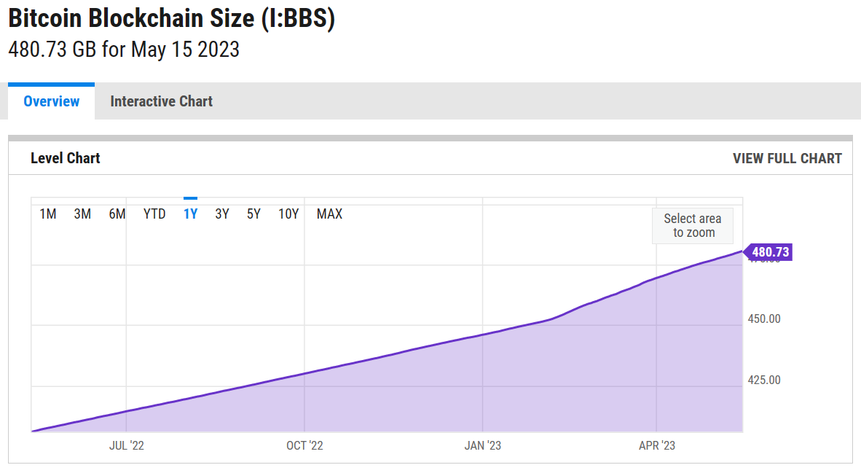
Ref. Bitcoin Blockchain Size

Slide 11
SPV Nodes (1/3)
For space- and power-constrained devices, a simplified payment verification (SPV) method is used to allow them to operate without storing the full blockchain.
As bitcoin adoption surges, the SPV node is becoming the most common form of bitcoin node, especially for bitcoin wallets.
SPV nodes download only the block headers and do not download the transactions included in each block. The resulting chain of blocks, without transactions, is 1,000 times smaller than the full blockchain.
SPV nodes cannot construct a full picture of all the UTXOs that are available for spending because they do not know about all the transactions on the network. SPV nodes verify transactions using a slightly different methodology that relies on peers to provide partial views of relevant parts of the blockchain on demand.

Slide 12
SPV Nodes (2/3)
SPV verifies transactions by reference to their depth in the blockchain instead of their height.
An SPV node will verify the chain of all blocks (but not all transactions) and link that chain to the transaction of interest.
E.g., when examining a transaction in block 300,000, a full node links all 300,000 blocks down to the genesis block and builds a full database of UTXO, establishing the validity of the transaction by confirming that the UTXO remains unspent.
An SPV node cannot validate whether the UTXO is unspent. Instead, the SPV node will establish a link between the transaction and the block that contains it, using a merkle path. Then, the SPV node waits until it sees the six blocks 300,001 through 300,006 piled on top of the block containing the transaction and verifies it by establishing its depth under blocks 300,006 to 300,001.

Slide 13
SPV Nodes (3/3)
The fact that other nodes on the network accepted block 300,000 and then did the necessary work to produce six more blocks on top of it is proof, by proxy, that the transaction was not a double-spend.
An SPV node cannot be persuaded that a transaction exists in a block when the transaction does not in fact exist. The SPV node establishes the existence of a transaction in a block by requesting a merkle path proof and by validating the Proof-of-Work in the chain of blocks.
However, a transaction’s existence can be “hidden” from an SPV node. An SPV node can definitely prove that a transaction exists but cannot verify that a transaction, such as a double-spend of the same UTXO, doesn’t exist because it doesn’t have a record of all transactions.
This vulnerability can be used in a denial-of-service attack or for a double-spending attack against SPV nodes. To defend against this, an SPV node needs to connect randomly to several nodes, to increase the probability that it is in contact with at least one honest node.

Slide 14
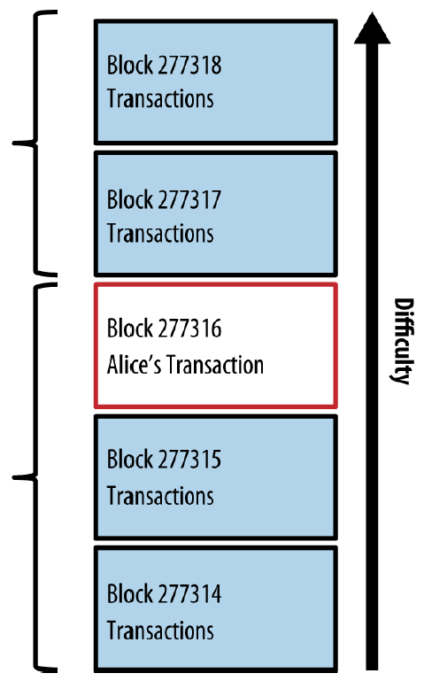
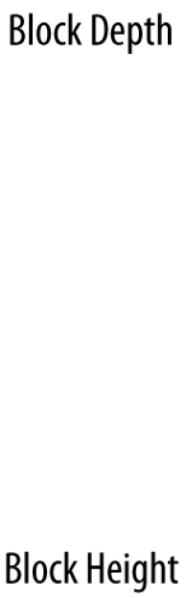
Block Depth & Height
Latest Block
(2)
# new blocks after the block of interest
(Alice -> Bob)
(277316)
Starting from block #0

Slide 15
Bloom Filters (1/8)
A bloom filter is a probabilistic search filter, a way to describe a desired pattern without specifying it exactly. Bloom filters offer an efficient way to express a search pattern while protecting privacy.
They are used by SPV nodes to ask their peers for transactions matching a specific pattern, without revealing which addresses, keys, or transactions they are searching for.
A more specific bloom filter will produce accurate results, but at the expense of revealing what patterns the SPV node is interested in, thus revealing the addresses owned by the user’s wallet.
A less specific bloom filter will produce more data about more transactions, many irrelevant to the node, but will allow the node to maintain better privacy.

Slide 16
Bloom Filters (2/8)
Bloom filters are implemented as a variable-size array of N binary digits (a bit field) and a variable number of M hash functions.
The hash functions are designed to always produce an output that is between 1 and N, corresponding to the array of binary digits. The hash functions are generated deterministically, so that any node implementing a bloom filter will always use the same hash functions and get the same results for a specific input.
By choosing different length (N) bloom filters and a different number (M) of hash functions, the bloom filter can be tuned, varying the level of accuracy and therefore privacy.

Slide 17
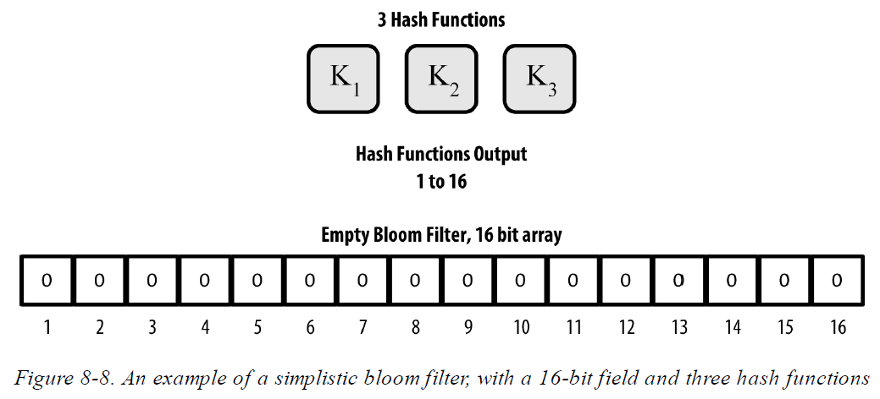
Bloom Filters (3/8)

Slide 18
Bloom Filters (4/8)
The bloom filter is initialized so that the array of bits is all zeros. To add a pattern to the bloom filter, the pattern is hashed by each hash function in turn.
Applying the first hash function to the input results in a number between 1 and N. The corresponding bit in the array (indexed from 1 to N) is found and set to 1, thereby recording the output of the hash function. Then, the next hash function is used to set another bit and so on.
In essence, as more patterns record on overlapping bits, the bloom filter starts to become saturated with more bits set to 1 and the accuracy of the filter decreases.
This is why the filter is a probabilistic data structure—it gets less accurate as more patterns are added.

Slide 19
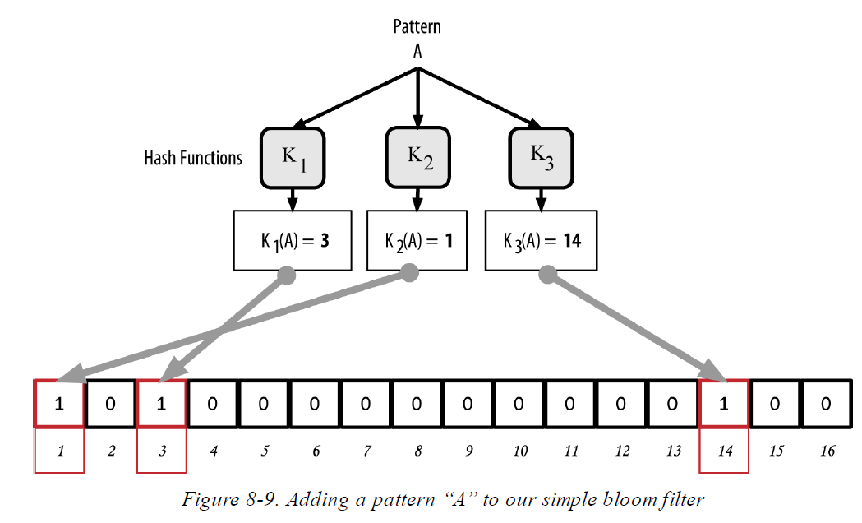
Bloom Filters (5/8)

Slide 20
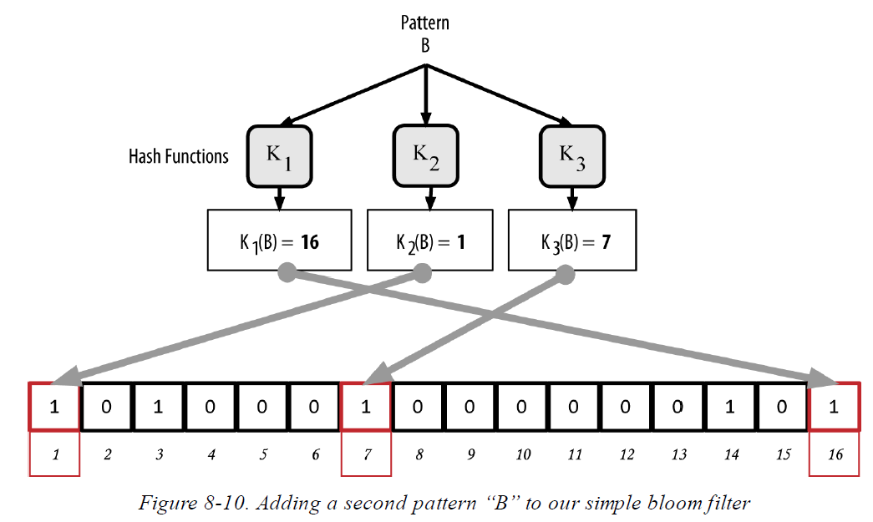
Bloom Filters (6/8)

Slide 21
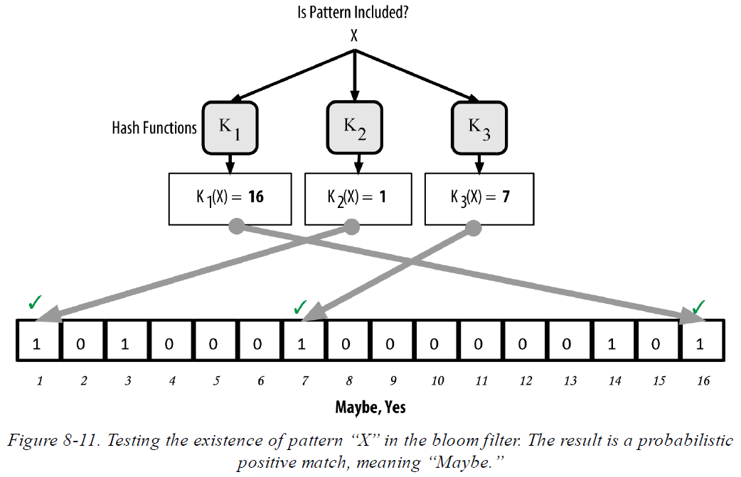
Bloom Filters (7/8)

Slide 22
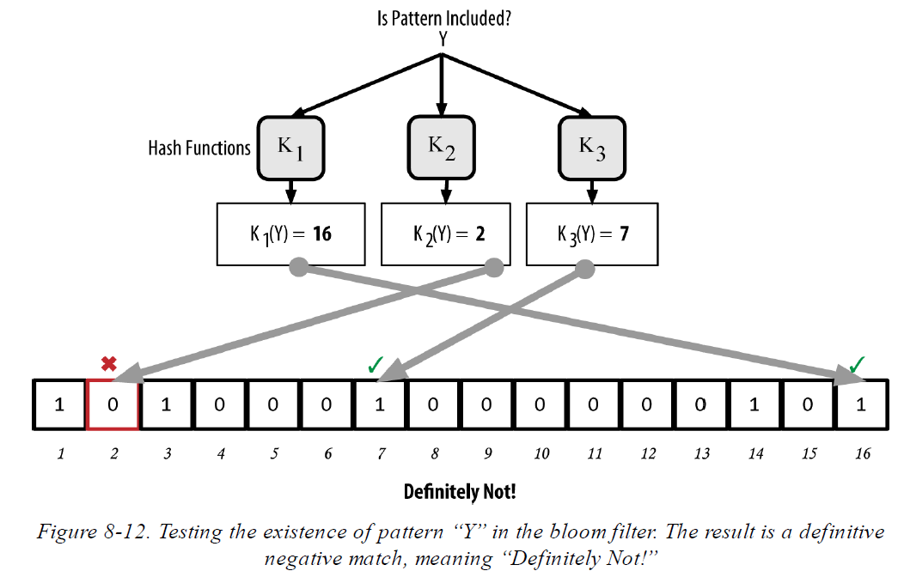
Bloom Filters (8/8)

Slide 23
How SPV Nodes Use Bloom Filters (1/2)
An SPV node will initialize a bloom filter as “empty”; in that state the bloom filter will not match any patterns. The SPV node will then make a list of all the addresses, keys, and hashes that it is interested in.
It will do this by extracting the public key hash and script hash and transaction IDs from any UTXO controlled by its wallet.
The SPV node then adds each of these to the bloom filter, so that the bloom filter will “match” if these patterns are present in a transaction, without revealing the patterns themselves.
The SPV node will then send a filterload message to the peer, containing the bloom filter to use on the connection.

Slide 24
How SPV Nodes Use Bloom Filters (2/2)
On the peer, bloom filters are checked against each incoming transaction. The full node checks several parts of the transaction against the bloom filter, looking for a match including:
The transaction ID. The data components from the locking scripts of each of the transaction outputs (every key and hash in the script). Each of the transaction inputs. Each of the input signature data components
After a filter is established, the peer will then test each transaction’s outputs against the bloom filter. Only transactions that match the filter are sent to the node.
As the full node sends transactions to the SPV node, the SPV node discards any false positives and uses the correctly matched transactions to update its UTXO set and wallet balance.

Slide 25
Transaction Pools
Almost every node on the bitcoin network maintains a temporary list of unconfirmed transactions called the memory pool, mempool, or transaction pool. Nodes use this pool to keep track of transactions that are known to the network but are not yet included in the blockchain.
E.g., a wallet node will use the transaction pool to track incoming payments to the user’s wallet that have been received on the network but are not yet confirmed.
As transactions are received and verified, they are added to the transaction pool and relayed to the neighboring nodes to propagate on the network.
Some implementations of the bitcoin client also maintain a UTXO database, which is the set of all unspent outputs on the blockchain.

Slide 26
The Blockchain (1/3)
The blockchain data structure is an ordered, back-linked list of blocks of transactions.
The blockchain is often visualized as a vertical stack, with blocks layered on top of each other and the first block serving as the foundation of the stack.
Each block within the blockchain is identified by a hash, generated using the SHA256 cryptographic hash algorithm on the header of the block.
Each block references a previous block, known as the parent block, through the “previous block hash” field in the block header. In other words, each block contains the hash of its parent inside its own header.
The sequence of hashes linking each block to its parent creates a chain going back all the way to the first block ever created, known as the genesis block.

Slide 27
The Blockchain (2/3)
Blockchain Forks
Although a block has just one parent, it can temporarily have multiple children. Multiple children arise during a blockchain “fork,” a temporary situation that occurs when different blocks are discovered almost simultaneously by different miners. Eventually, only one child block becomes part of the blockchain and the “fork” is resolved.
The “previous block hash” field is inside the block header and thereby affects the current block’s hash.
The child’s own identity changes if the parent’s identity changes. This cascade effect ensures that once a block has many generations following it, it cannot be changed without forcing a recalculation of all subsequent blocks.

Slide 28
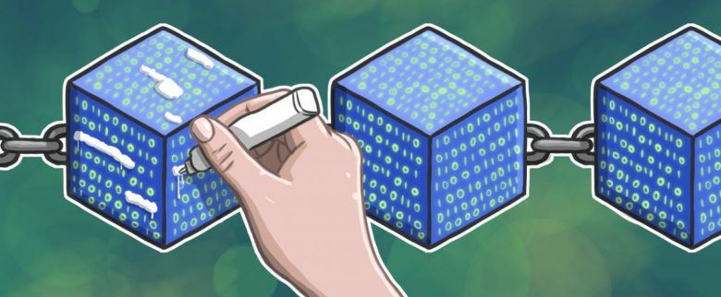
The Blockchain (3/3)
Because such a recalculation would require enormous computation, the existence of a long chain of blocks makes the blockchain’s deep history immutable, which is a key feature of bitcoin’s security.
In the blockchain, the most recent few blocks might be revised if there is a chain recalculation due to a fork. But once you go more deeply into the blockchain, beyond six blocks, blocks are less and less likely to change.

Slide 29
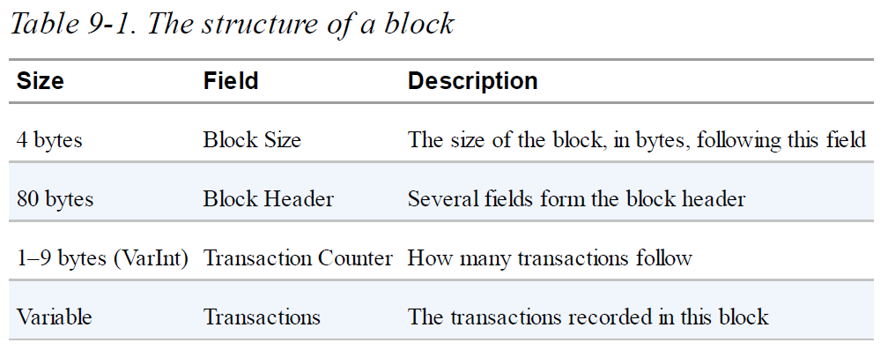
Structure of a Block (1/2)
A block is a container data structure that aggregates transactions for inclusion in the public ledger, the blockchain.
The block is made of a header, containing metadata, followed by a long list of transactions that make up the bulk of its size.

Slide 30
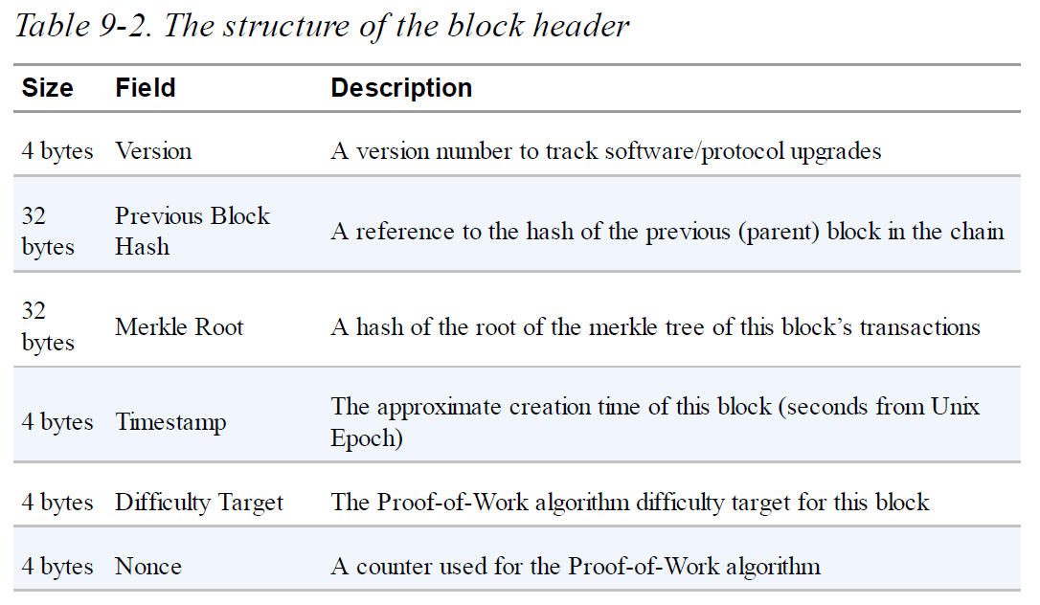
Structure of a Block (2/2)
Relate to the mining competition

Slide 31
Block Identifiers
Block Header Hash
The primary identifier of a block is its cryptographic hash, a digital fingerprint, made by hashing the block header twice through the SHA256 algorithm.
Note that the block header hash is not actually included inside the block’s data structure. It is computed by each node as the block is received from the network. (Might be stored in a separate database table to facilitate indexing.)
Block Height
A second way to identify a block is by its position in the blockchain, called the block height.
Unlike the block hash, the block height is not a unique identifier. Two or more blocks might have the same block height, competing for the same position in the blockchain. (Blockchain Forks)

Slide 32
The Genesis Block
The first block in the blockchain is called the genesis block and was created in 2009. It is the common ancestor of all the blocks in the blockchain, meaning that if you start at any block and follow the chain backward in time, you will eventually arrive at the genesis block.
Every node always starts with a blockchain of at least one block because the genesis block is statically encoded within the bitcoin client software, such that it cannot be altered.
The genesis block contains a hidden message within it. The coinbase transaction input contains the text “The Times 03/Jan/2009 Chancellor on brink of second bailout for banks.” This message was intended to offer proof of the earliest date this block was created, by referencing the headline of the British newspaper The Times.

Slide 33
Linking Blocks in the Blockchain (1/2)
As a node receives incoming blocks from the network, it will validate these blocks and then link them to the existing blockchain.
For example
A node has 277,314 blocks in the local copy of the blockchain. The last block the node knows about is block 277,314, with its block header hash. The bitcoin node then receives a new block from the network.
Looking at this new block, the node finds the previousblockhash field, which contains the hash of its parent block. It is a hash known to the node, that of the last block on the chain at height 277,314. Therefore, this new block is a child of the last block on the chain and extends the existing blockchain. The node adds this new block to the end of the chain, making the blockchain longer with a new height of 277,315.

Slide 34
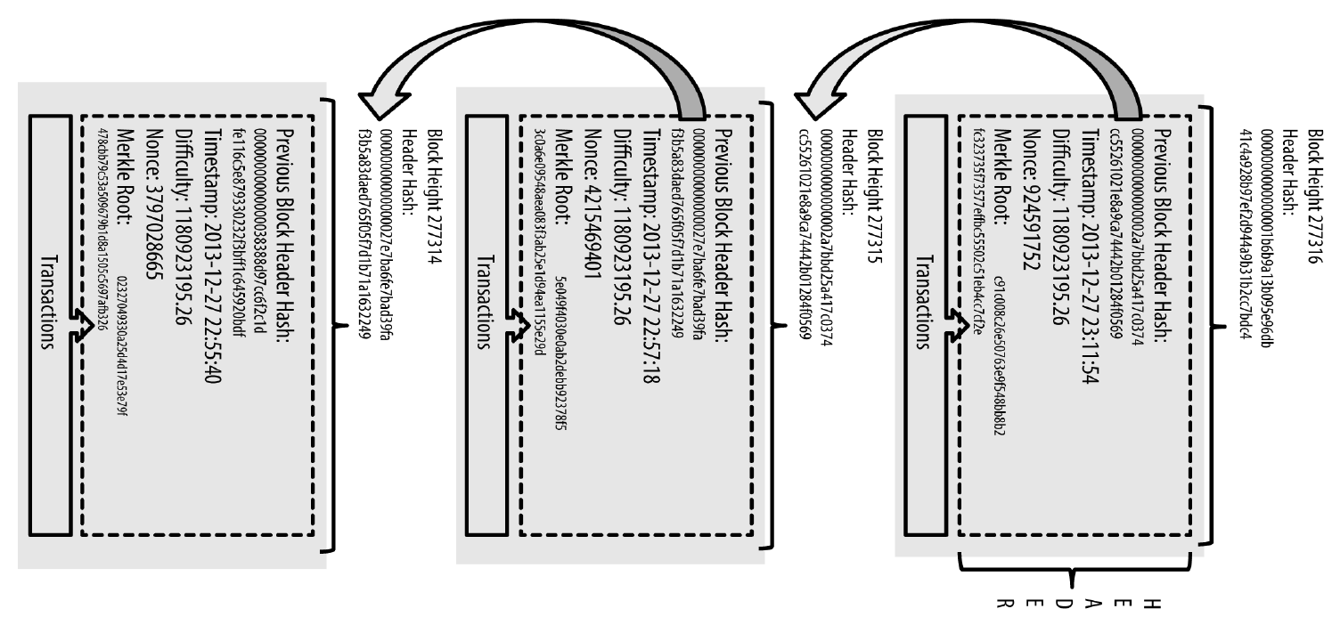
Linking Blocks in the Blockchain (2/2)

Slide 35
Merkle Trees (1/4)
Each block in the bitcoin blockchain contains a summary of all the transactions in the block using a merkle tree.
A merkle tree, also known as a binary hash tree, is a data structure used for efficiently summarizing and verifying the integrity of large sets of data.
Merkle trees are used in bitcoin providing a very efficient process to verify whether a transaction is included in a block.
A merkle tree is constructed by recursively hashing pairs of nodes until there is only one hash, called the root, or merkle root. The cryptographic hash algorithm used in bitcoin’s merkle trees is SHA256 applied twice, also known as double-SHA256.
When N data elements are hashed and summarized in a merkle tree, you can check to see if any one data element is included in the tree with at most 2*log (N) calculations, making this a very efficient data structure.

Slide 36
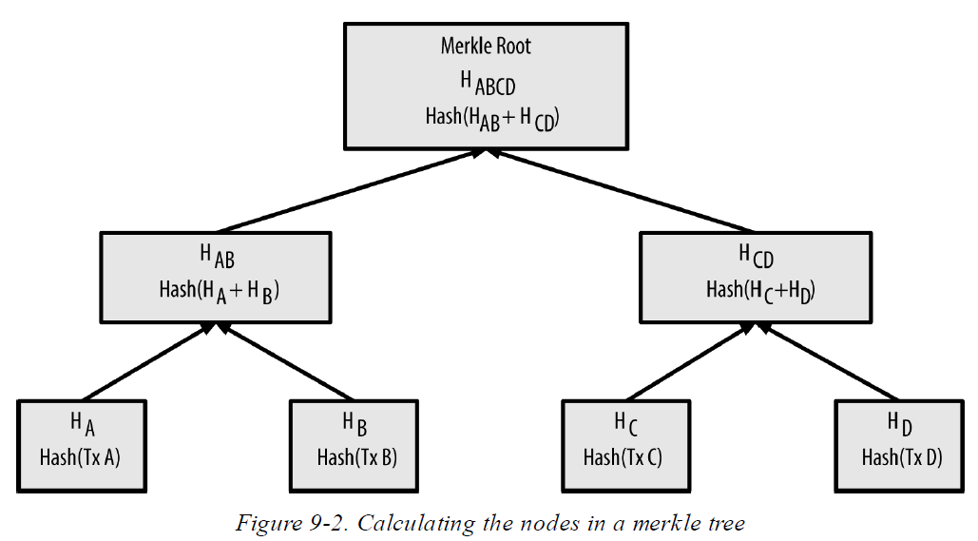

Merkle Trees (2/4)
E.g. Four transactions, A, B, C, and D, form the leaves of the merkle tree

Slide 37
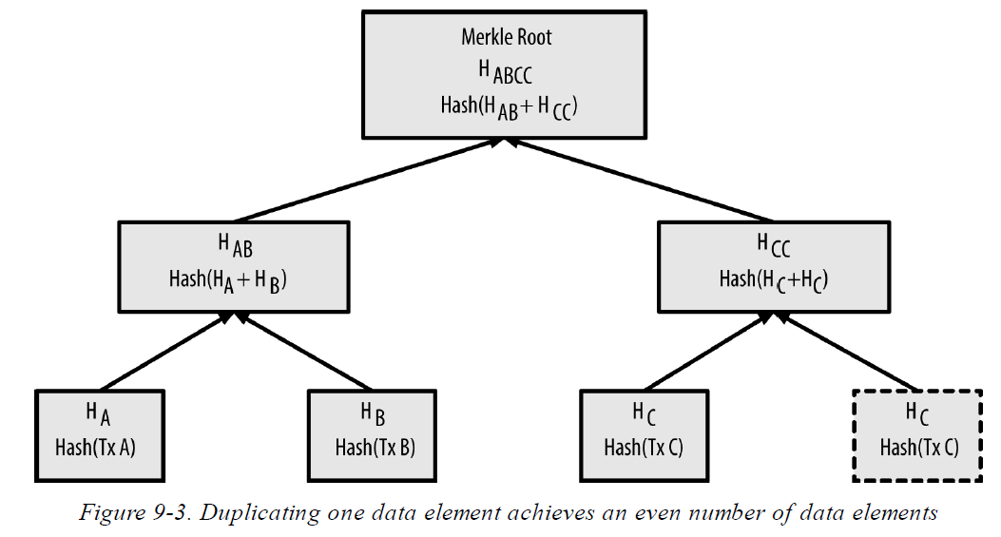
Merkle Trees (3/4)

Slide 38
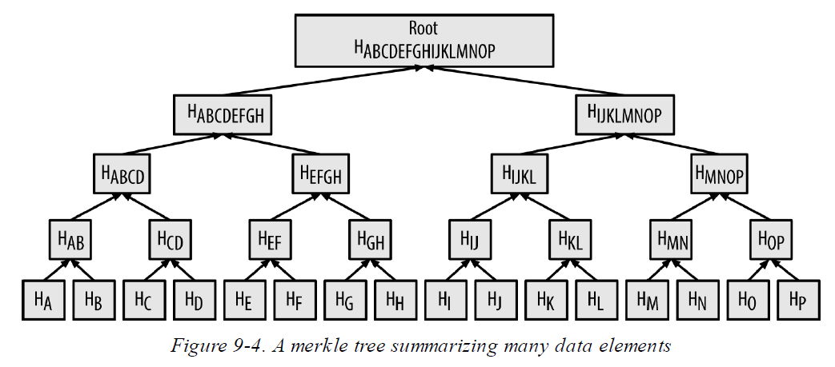
Merkle Trees (4/4)
Whether there is one transaction or a hundred thousand transactions in the block, the merkle root always summarizes them into 32 bytes.

Slide 39
Merkle Path (1/2)
To prove that a specific transaction is included in a block, a node only needs to produce log (N) 32-byte hashes, constituting an authentication path or merkle path connecting the specific transaction to the root of the tree.
In Figure 9-5 (next slide), a node can prove that a transaction K is included in the block by producing a merkle path with only four 32-byte hashes long (128 bytes total).
The path consists of the four hashes: H_{L} , H_{IJ} , H_{MNOP} , and H_{ABCDEFGH}
With the four hashes, any node can prove that H_{K} is included in the merkle root by computing four additional pair-wise hashes H_{KL} , H_{IJKL} , H_{IJKLMNOP} , and the merkle tree root.

Slide 40
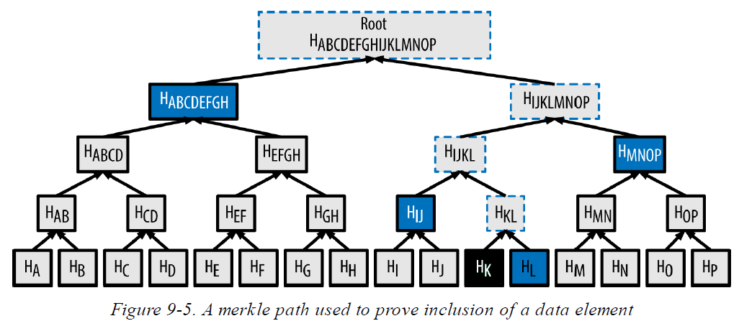
Merkle Path (2/2)
(Prove that a transaction K is included in the block)

Slide 41
Merkle Trees and SPV (1/2)
Merkle trees are used extensively by SPV nodes. SPV nodes don’t have all transactions and do not download full blocks, just block headers. In order to verify that a transaction is included in a block, without having to download all the transactions in the block, they use an authentication path, or merkle path.
Consider, for example, an SPV node that is interested in incoming payments to an address contained in its wallet. The SPV node will establish a bloom filter on its connections to peers to limit the transactions received to only those containing addresses of interest.
When a peer sees a transaction that matches the bloom filter, it will send that block using a merkleblock message. The merkleblock message contains the block header as well as a merkle path that links the transaction of interest to the merkle root in the block.

Slide 42
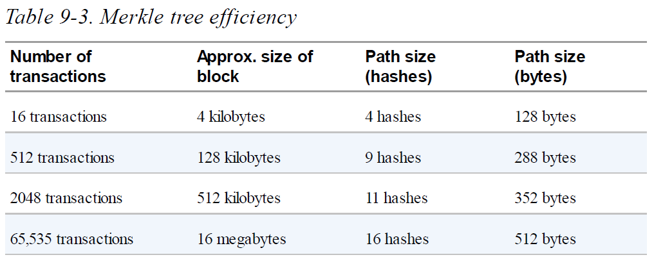
Merkle Trees and SPV (2/2)
The SPV node can use this merkle path to connect the transaction to the block and verify that the transaction is included in the block.
The SPV node will have received less than a kilobyte of data for the block header and merkle path, an amount of data that is more than a thousand times less than a full block.

Slide 43
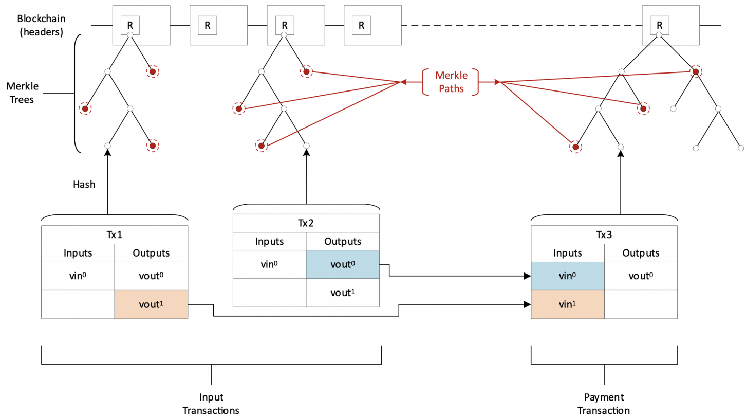
Ref. Merkle Tree and SPV
https://wiki.bitcoinsv.io/index.php/Simplified_Payment_Verification

Slide 44

Bitcoin’s Test Blockchains
The “main” bitcoin blockchain, the one created by Satoshi Nakamoto on January 3rd, 2009, is called mainnet.
There are other bitcoin blockchains that are used for testing purposes: testnet, segnet, and regtest.
Bitcoin’s various blockchains (regtest, segnet, testnet3, mainnet) offer a range of testing environments for bitcoin development. Use the test blockchains whether you are developing for Bitcoin Core, or another fullnode consensus client; an application such as a wallet, exchange, ecommerce site; or even developing novel smart contracts and complex scripts.

